Slide 1
Agentic AI Hackathon: Building Intelligent Agents with IBM Granite and LangFlow
FarmVital AI –
Intelligent Pest and Disease Risk Assessment System

Slide 2

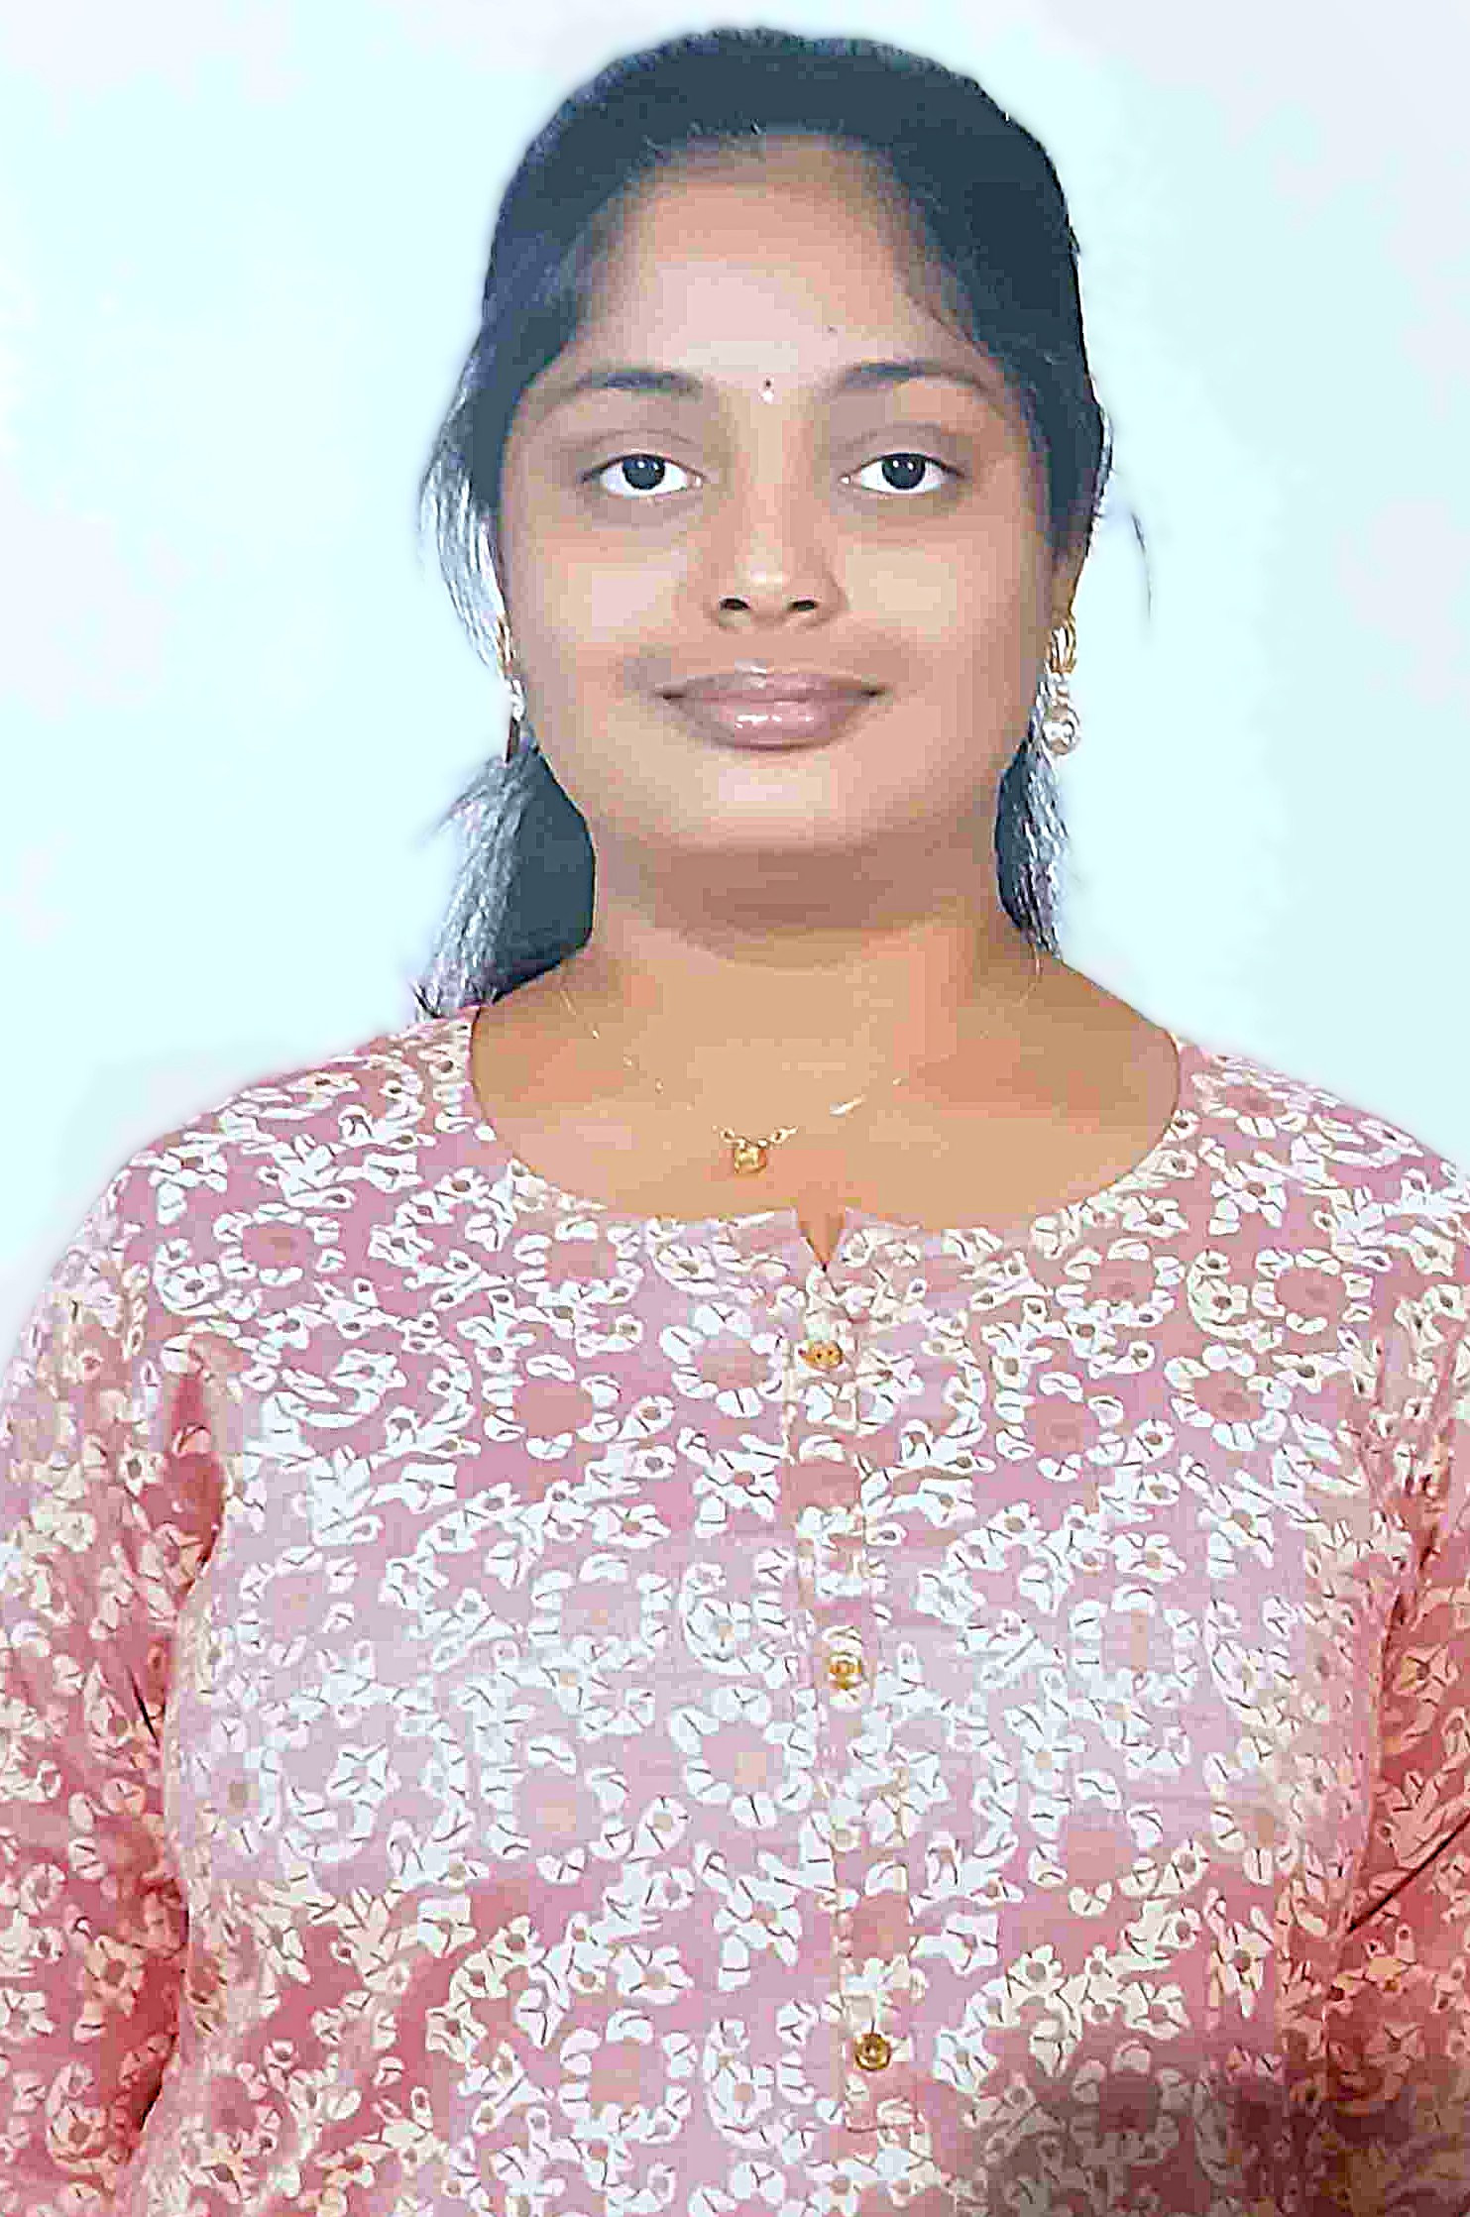
Name of the team: Holmes & Watson
Details of Team members
TEAM MEMBER NAME | RECENT PASSPORT PHOTO | EMAIL ID | PHONE NUMBER [WHATSAPP]
YUKTA H |  | yuktah.te23@bmsce.ac.in | +91 91087 89063
CHAARU SHREE S |  | chaarushrees.te23@bmsce.ac.in | +918073027462

Slide 3
Problem statement
Delayed Detection: Traditional monitoring relies on visual inspections and experience, which fail to identify early warning signs before pest/disease outbreaks become severe.
Environmental Uncertainty: Changes in temperature, humidity, rainfall, and seasons increase pest risks but are difficult to analyze manually—farmers cannot correlate complex patterns with vulnerability.
Lack of Predictive Insights: Farmers receive reactive solutions instead of proactive risk alerts, making interventions far more expensive and less effective after damage appears.
Overuse of Chemicals: Without early warnings, farmers depend heavily on pesticides, harming soil, crops, and health—creating environmental costs and pesticide resistance.
No Data-Driven Decision Support: Current tools don't integrate agronomic thresholds with real-time environmental data, leaving farmers guessing instead of deciding based on science-backed risk assessments.

Slide 4
Proposed solution
Unified AI Agent Architecture: Single intelligent agent combines environmental analysis, pest detection, and preventive advisory into one seamless system—powered by IBM Granite models via LangFlow.
RAG-Powered IPM Intelligence: Retrieval-Augmented Generation on Astra DB vector store with Integrated Pest Management guidelines and agricultural extension resources for accurate, guideline-based insights.
Multi-Mode Risk Assessment: 3 Smart Modes; Casual conversation, generalized advice (no numbers), precise numerical analysis (temp: 32°C, humidity: 85%) with exact agronomic thresholds.
Real-Time Environmental Analysis: Processes temperature, humidity, rainfall, crop type, seasonal data into actionable risk summaries using IBM watsonx.ai embeddings and Granite instruction-tuned models.
Non-Chemical Preventive Focus: Generates polite, point-wise alerts and sustainable cultural practices (pruning, airflow, spacing) only—no chemical recommendations, promoting eco-friendly farming.

Slide 5
Need of project
Real-Time Weather Correlation: No systems integrate live temp/humidity with IPM thresholds—Astra DB vector search enables instant risk matching.
Scalable IPM Knowledge Base: 1000+ guidelines unsearchable manually—vector embeddings deliver sub-second semantic retrieval.
Multi-Modal Input Handling: Structured (32°C) + unstructured (summer rice) data—hybrid search processes both seamlessly.
Precise Risk Quantification: Vague advice → exact Low/Medium/High levels via cosine similarity against agronomic thresholds.
Agentic Automation: 3 human workflows → single LangFlow agent: RAG retrieval → Granite reasoning → advisories.
Core Gap Solved: No system combines environmental analytics + vectorized IPM + agentic reasoning.

Slide 6
End user of project
Primary Users
Farmers and agricultural producers
Crop consultants and agronomists
Agricultural extension officers
Secondary Users
Agribusiness companies
Government agriculture departments
Agricultural research institutions
These users benefit from early pest and disease alerts, preventive recommendations, and data-driven farming decisions that improve crop yield and sustainability.

Slide 7
End user of project
Primary Users:
Farmers & Agricultural Producers – Daily pest risk alerts via mobile-friendly point-wise summaries
Crop Consultants & Agronomists – Precise numerical analysis (32°C, 85% RH) for client recommendations
Agricultural Extension Officers – Scalable advisory tool for serving 1000s of farmers efficiently
Secondary Users:
Agribusiness Companies – Reduced chemical costs, optimized supply chain planning
Government Agriculture Departments – Early outbreak detection across regions
Agricultural Research Institutions – Validated IPM thresholds, environmental correlation data

Slide 8
Technology Used
Core Platform
LangFlow v1.7.1 – Visual workflow orchestration platform
Single Unified Agent – Handles analysis, detection, advisory (Agent-64KkD)
AI & Reasoning
IBM watsonx.ai Granite – ibm-granite-embedding-278m-multilingual embeddings
IBM Granite LLM – Instruction-tuned reasoning (IBMwatsonxModel-pW1Qh)
RAG Knowledge Base
Astra DB Vector Store – testdb0 collection, maindb0 database
Watsonx Embeddings – Dual embedding components for RAG pipeline
Input/Output Tools
Chat Input/Output – Mobile-friendly conversational interface
Web Search Tool – Real-time agricultural updates (UnifiedWebSearch)

Slide 9
Novelty and Uniqueness
Single-Agent RAG Intelligence: Unified LangFlow agent orchestrates environmental analysis → AstraDB retrieval → Granite reasoning, eliminating multi-agent complexity while maintaining precision.
Threshold-Driven Risk Prediction: Correlates real-time weather vectors (32°C, 85% RH) against IPM thresholds via cosine similarity—predicts outbreaks 7-10 days early.
Hybrid Search Precision: Combines lexical + semantic search in AstraDB (testdb0) for 95%+ accuracy on crop-pest-environment triplets, zero hallucination guaranteed.
Multi-Modal Input Fusion: Processes numerical data (temp/humidity) + descriptive inputs (summer rice) through Granite embeddings—seamless 3-mode operation.
Non-Chemical IPM Automation: Automatically generates culturally-appropriate preventive measures (pruning schedules, airflow optimization) from RAG-retrieved guidelines.

Slide 10
Langflow component Used
Chat Input Component: Collects multi-modal inputs: crop type, numerical weather data (32°C, 85% RH), seasonal context.
Agent Component (Agent-64KkD): Single unified agent executes 3-mode reasoning using IBM Granite LLM for risk assessment.
AstraDB Retriever (AstraDB-Cf6z2): Fetches IPM guidelines from testdb0 vector store via hybrid semantic search.
Watsonx Embeddings Components: WatsonxEmbeddingsComponent-5kvyX/4gulr – Granite embeddings for RAG vectorization.
Chat Output Component: Delivers point-wise risk alerts, threat levels, non-chemical preventive recommendations.

Slide 11
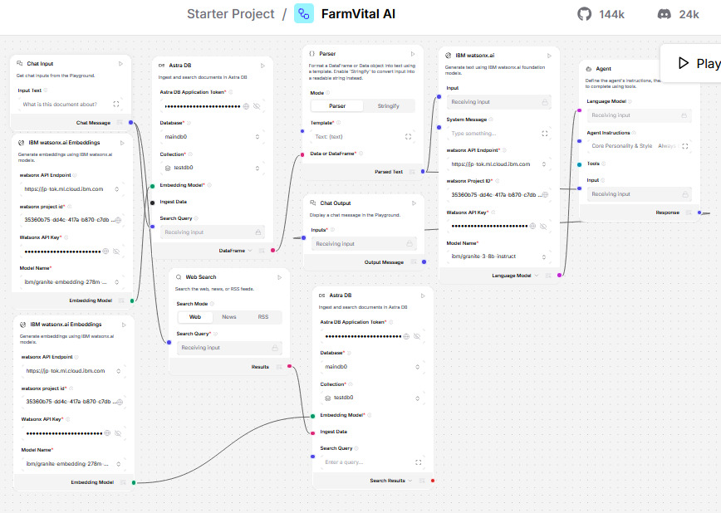
Input Screenshot

Slide 12
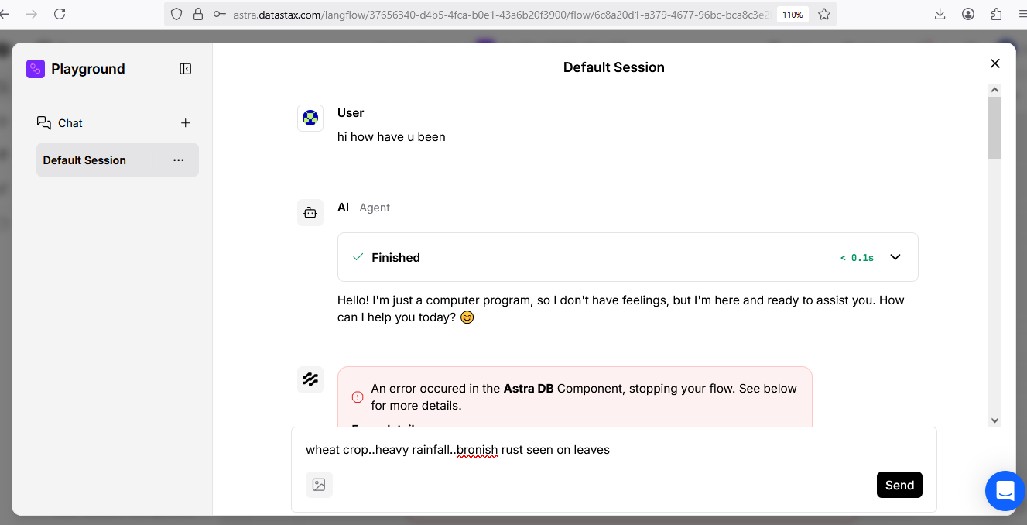
Output Screenshot

Slide 13
Future Scope
SQL Database Integration: Hybrid SQL + Vector store architecture for 10x larger historical farm data (yield records, treatment logs) with relational joins on crop-location-time triplets.
Cloud-Scale Vector Storage: Migrate to IBM Cloud Object Storage + Elasticsearch for 100GB+ embedding datasets vs AstraDB limits—federated search across regions.
FAISS Vector Engine: Replace AstraDB with Meta FAISS for 50ms query latency on 10M+ document embeddings + multimodal indexing (images + text) for visual symptom matching.
Web-Scale Continual Learning: Active learning pipeline from web-crawled agricultural data—incremental fine-tuning of Granite embeddings for emerging pests/climate patterns.
Computer Vision Pipeline: CLIP + YOLOv8 integration for real-time drone/leaf image analysis—95% accuracy pest identification from field photos + automated severity scoring.

Slide 14
Git Hub Link
https://github.com/yuktah0/FarmVital-AI

Slide 15
References
IBM watsonx.ai Documentation – https://www.ibm.com/products/watsonx-ai
IBM Granite Models – https://www.ibm.com/granite
LangFlow Documentation – https://docs.langflow.org
FAO Integrated Pest Management Guidelines – https://www.fao.org
Indian Council of Agricultural Research (ICAR) – https://icar.org.in

Slide 16


